Slide 1
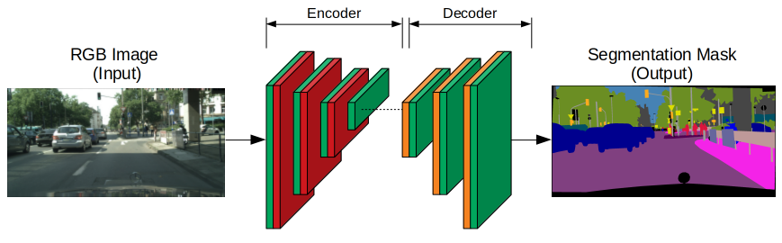
Semantic Segmentation: Every Pixel Counts
Semantic Segmentation is the process of pixel-level classification, where every single pixel in an image is assigned a category label.
The U-Net architecture is the gold standard for this task, particularly in medical and scientific fields.
Unlike classification, the output of a segmentation model is a "mask"—a 2D grid of the same size as the input image.

Slide 2
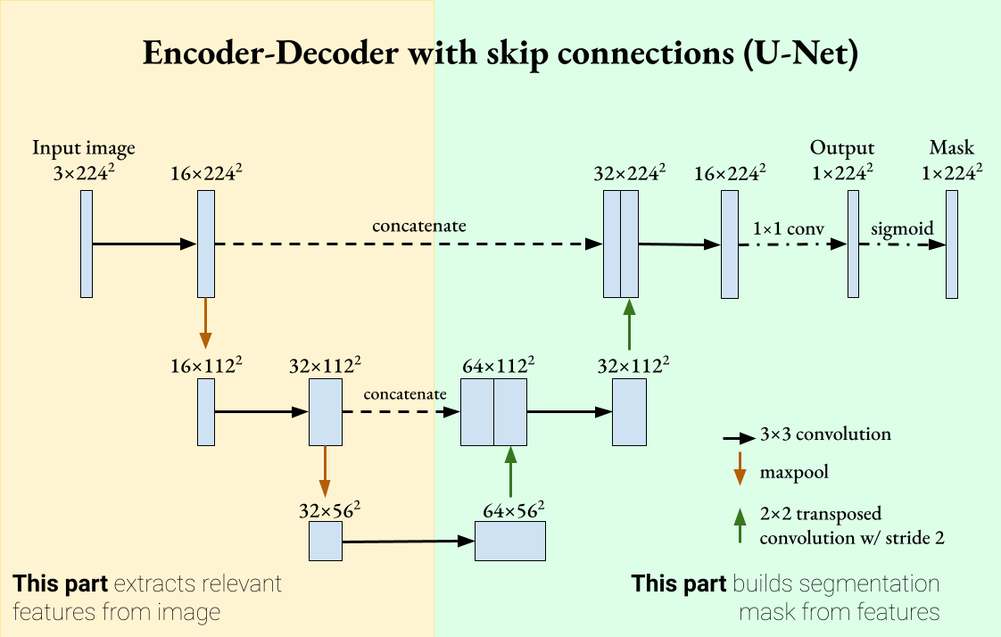
Skip Connections: Recovering the Fine Details
U-Net consists of a contracting path (Encoder) to capture context and a symmetric expanding path (Decoder) to enable precise localization.
As images are downsampled in the encoder, fine spatial information is often lost.
Skip Connections solve this by passing high-resolution feature maps from the encoder directly to the corresponding layers in the decoder.
This allows the model to recover spatial detail, which is critical for creating high-precision masks in medical scans.

Slide 3
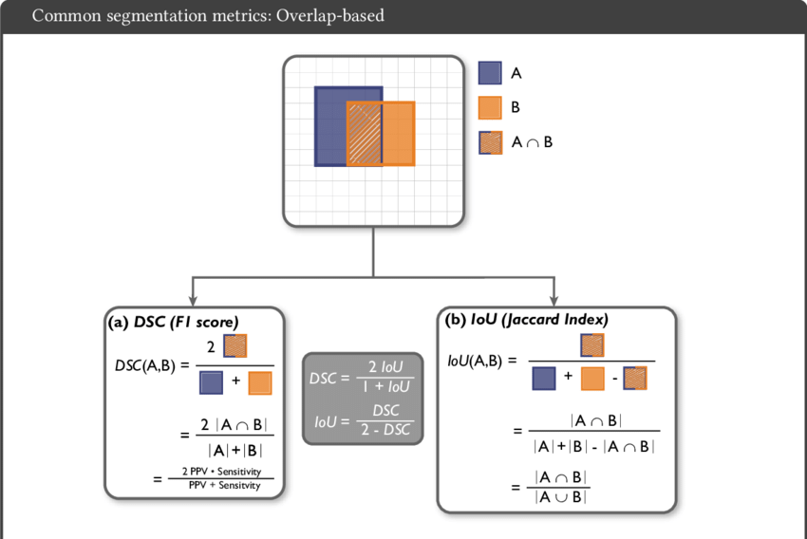
Dice Loss and Jaccard Index
In segmentation, standard accuracy is often misleading because the background usually takes up 99% of the pixels.
Dice Loss: Specifically designed to measure the overlap between the predicted mask and the ground truth.
Jaccard Index (IoU): Another precision metric used instead of standard accuracy to evaluate how well the predicted mask matches the target.

